Slide 1
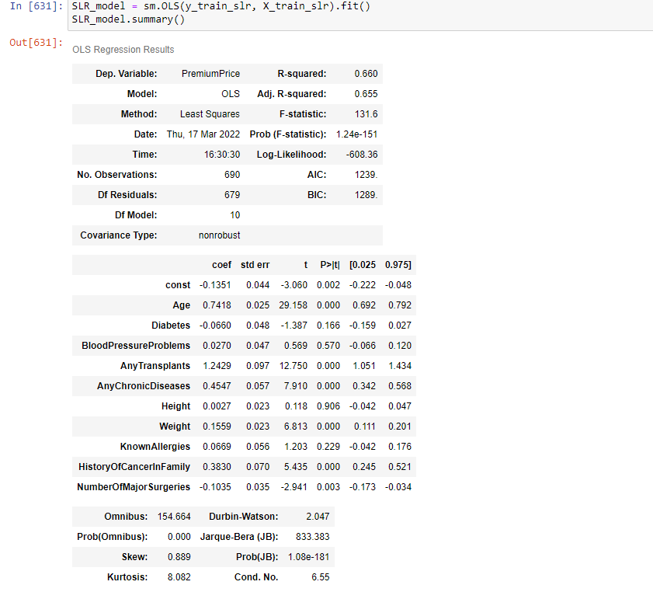
Base Model
We prepared a base model using OLS Linear Regression.
We used all the variables.
For Feature Scaling we use standard scaler.
Train test split : (70:30)
Train: 690 rows
Test: 296 rows
Insights for base model:
R2 value : 0.66
Adj R2 value : 0.65
Conditional number is 6.53 ->No multicollinearity.
MSE: Train->0.38, Test ->0.28
RMSE: Train ->0.62, Test-> 0.53
MAE: Train -> 0.44, Test- > 0.39

Slide 2
Feature Engineering & Feature Selection
Used Feature Selection Technique for getting best features
Selected Features for final model using forward selection(compared RMSE values):
Age
AnyTransplants
AnyChronicDiseases
Weight
KnownAllergies
HistoryOfCancerInFamily
NumberOfMajorSurgeries
Tuned features by Hyper parameters tuning.
For test models we also bins features { ‘Age’ and ’BMI’}

